Slide 1
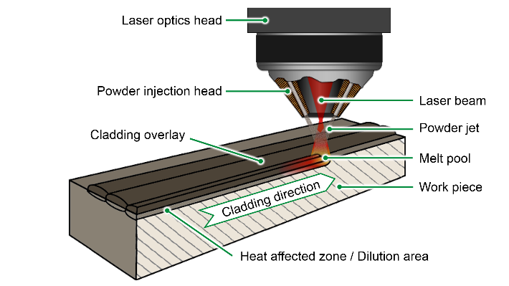
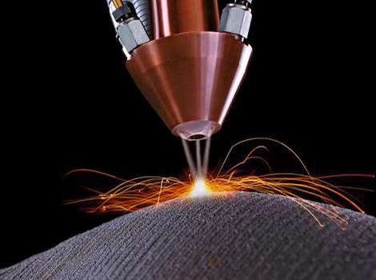
MODELING OF LASER CLADDING
Powder distribution, Melting, Ricochet
Laser, Optics,
Intensity Distribution
Melt Pool Dynamics
Buoyancy, Surface tension,
Marangoni effect
Solidification,
Stefan Problem,
Three Phase
Deposition geometry
Mellurgical effects
Residual Stress
Preliminary Objectives
Develop a model to predict the temperature and stress distribution of the Laser cladding process
Code various phenomenological equations to estimate some secondary variables:
Hardness
Phase Transformations and its effects
Grain size
Facilities are available in the machine tool laboratory if you want to conduct some preliminary experiments to validate your computational model

Slide 2
Solidification modeling of Laser Cladding
Powder distribution, Melting, Ricochet
Laser, Optics,
Intensity Distribution
Melt Pool Dynamics
Buoyancy, Surface tension,
Marangoni effect
Solidification,
Stefan Problem,
Three Phase
Deposition geometry
Mellurgical effects
Residual Stress
Preliminary Objectives
Develop a model to estimate velocities, cooling rate, solidification rate and the geometry of a Laser cladding process
Code various phenomenological equation to estimate
Marangoni Effect
Phase Fractions
Many other secondary variables of importance
Facilities are available in the machine tool laboratory if you want to conduct some preliminary experiments to validate your computational model

Slide 3
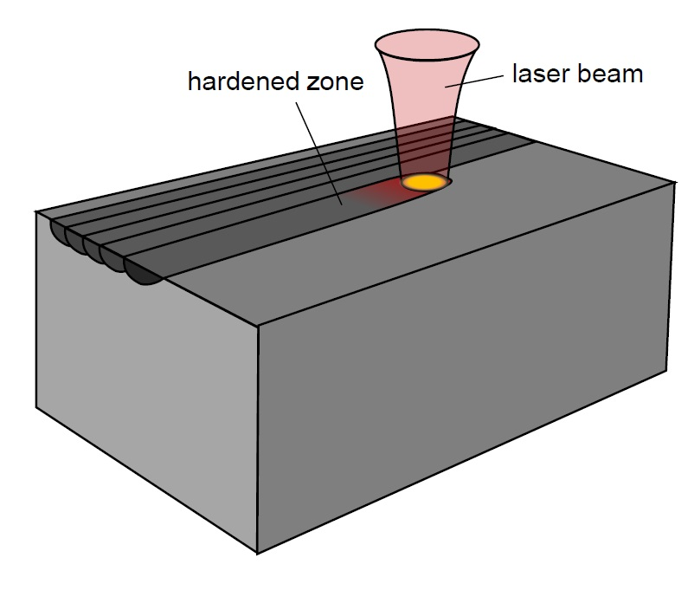
Analysis of laser surface hardening
Preliminary Objectives
Develop a model to predict the temperature and stress distribution of the Laser surface hardening process
Code various phenomenological equations to estimate some secondary variables:
Hardness
Phase Transformations and its effects
Grain size
Facilities are available in the machine tool laboratory if you want to conduct some preliminary experiments to validate your computational model

